Slide 1







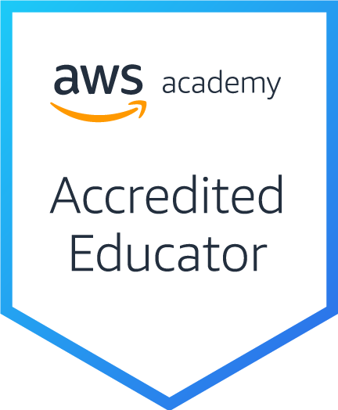
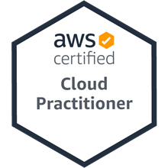
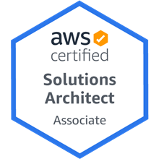
Cloud Computing Architecture for Artificial Intelligence (人工智慧雲端運算架構)
Tamkang University
Host: 閆立中, TKU AI創智社社長
Time: 18:00-20:00, May 24, 2022 (Tuesday) Place: TKU AII Club, MS Teams
戴敏育 副教授
Min-Yuh Day, Ph.D, Associate Professor
國立臺北大學 資訊管理研究所
Institute of Information Management, National Taipei University
https://web.ntpu.edu.tw/~myday
2022-05-24

Slide 2


戴敏育 博士 (Min-Yuh Day, Ph.D.)
1
國立臺北大學 資訊管理研究所 副教授
中央研究院 資訊科學研究所 訪問學人
國立臺灣大學 資訊管理 博士
Publications Co-Chairs, IEEE/ACM International Conference on Advances in Social Networks Analysis and Mining (ASONAM 2013- )
Program Co-Chair, IEEE International Workshop on Empirical Methods for Recognizing Inference in TExt (IEEE EM-RITE 2012- )
Publications Chair, The IEEE International Conference on Information Reuse and Integration for Data Science (IEEE IRI)

Slide 3
Outline
Cloud Computing Architecture for AI
AWS Certifications Roadmap for Machine Learning
AWS Serverless Architecture

Slide 4
Cloud Computing Architecture

Slide 5
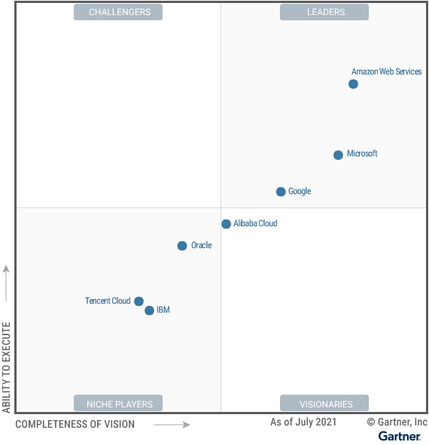
Gartner Magic Quadrant for Cloud Infrastructure and Platform Services
Amazon Web Services
Microsoft
Google
Source: https://www.gartner.com/doc/reprints?id=1-271OE4VR&ct=210802

Slide 6
Software as a service
Software customers
Software provider
Software services
Cloud Infrastructure
Cloud provider

Slide 7
Multi-tier client-server architecture
Client 1
Client 2
Web Server
Application Server
Database Server
Client 3
Client …

Slide 8
Service-oriented Architecture
Client 1
S1
S2
Client 2
S3
Web Server
Service gateway
S4
Client 3
S5
Client …
S6
Services

Slide 9
VM
Container
Virtual web server
Virtual mail server
User 1 Container 1
User 2 Container 2
Server software
Server software
Application software
Application software
Guest OS
Guest OS
Server software
Server software
Hypervisor
Container manager
Host OS
Host OS
Server Hardware
Server Hardware

Slide 10
Everything as a service
Photo editing
Software as a service (SaaS)
Logistics management
Cloud management Monitoring
Platform as a service (PaaS)
Database
Software development
Storage Network
Infrastructure as a service (IaaS)
Computing Virtualization
Cloud data center

Slide 11
Artificial Intelligence (AI)

Slide 12
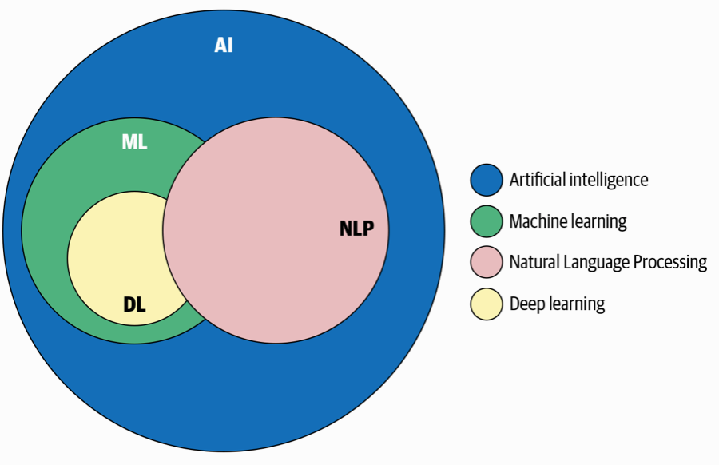
AI, NLP, ML, DL
Source: Sowmya Vajjala, Bodhisattwa Majumder, Anuj Gupta (2020), Practical Natural Language Processing: A Comprehensive Guide to Building Real-World NLP Systems, O'Reilly Media.

Slide 13
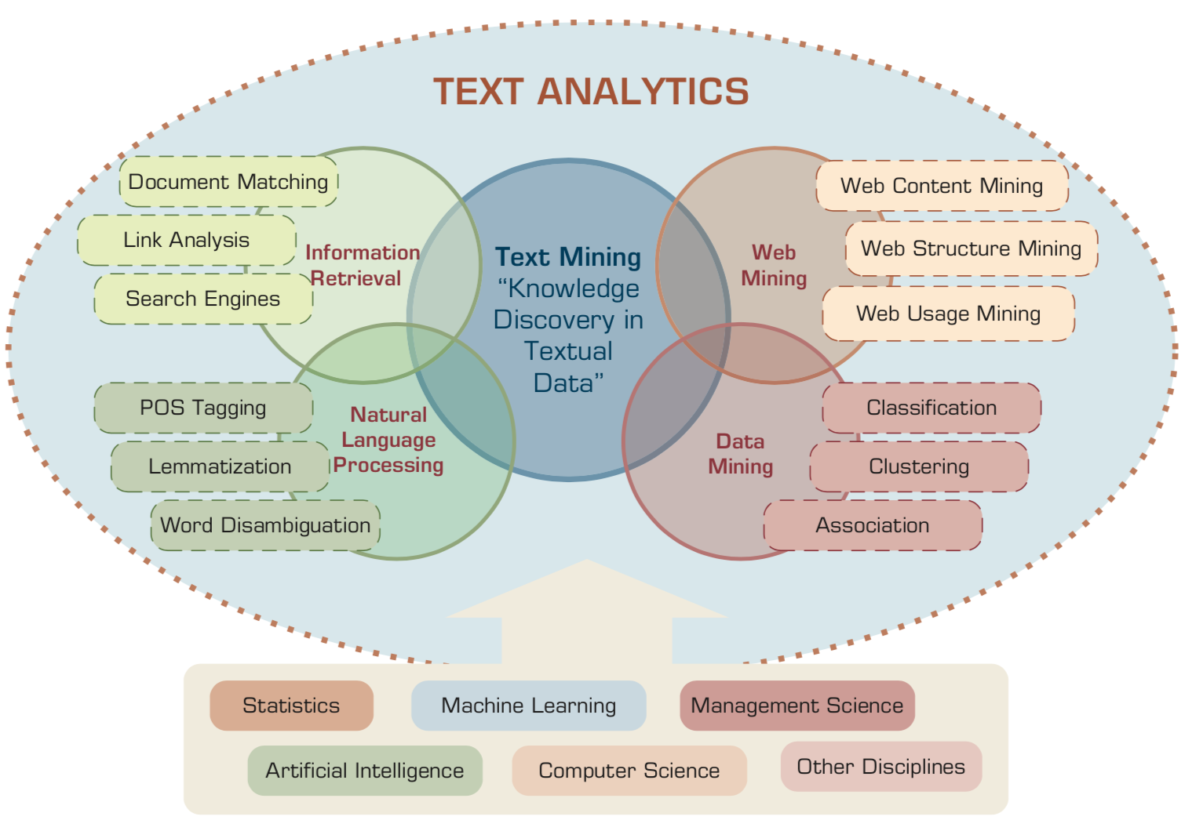
Text Analytics and Text Mining
Source: Ramesh Sharda, Dursun Delen, and Efraim Turban (2017), Business Intelligence, Analytics, and Data Science: A Managerial Perspective, 4th Edition, Pearson

Slide 14
AI, Big Data, Cloud Computing Evolution of Decision Support, Business Intelligence, and Analytics
AI
AI
Cloud Computing
Big Data
DM
BI
Source: Ramesh Sharda, Dursun Delen, and Efraim Turban (2017), Business Intelligence, Analytics, and Data Science: A Managerial Perspective, 4th Edition, Pearson

Slide 15
The Rise of AI
Source: DHL (2018), Artificial Intelligence in Logistics, http://www.globalhha.com/doclib/data/upload/doc_con/5e50c53c5bf67.pdf/

Slide 16
Definition of Artificial Intelligence (A.I.)

Slide 17
Artificial Intelligence “… the science and engineering of making intelligent machines” (John McCarthy, 1955)
Source: https://digitalintelligencetoday.com/artificial-intelligence-defined-useful-list-of-popular-definitions-from-business-and-science/

Slide 18
Artificial Intelligence “… technology that thinks and acts like humans”
Source: https://digitalintelligencetoday.com/artificial-intelligence-defined-useful-list-of-popular-definitions-from-business-and-science/

Slide 19
Artificial Intelligence “… intelligence exhibited by machines or software”
Source: https://digitalintelligencetoday.com/artificial-intelligence-defined-useful-list-of-popular-definitions-from-business-and-science/

Slide 20
4 Approaches of AI
Thinking Humanly | Thinking Rationally
Acting Humanly | Acting Rationally
Source: Stuart Russell and Peter Norvig (2020), Artificial Intelligence: A Modern Approach, 4th Edition, Pearson

Slide 21
4 Approaches of AI
2. Thinking Humanly: The Cognitive Modeling Approach | 3. Thinking Rationally: The “Laws of Thought” Approach
1. Acting Humanly: The Turing Test Approach (1950) | 4. Acting Rationally: The Rational Agent Approach
Source: Stuart Russell and Peter Norvig (2020), Artificial Intelligence: A Modern Approach, 4th Edition, Pearson

Slide 22
AI Acting Humanly: The Turing Test Approach (Alan Turing, 1950)
Knowledge Representation
Automated Reasoning
Machine Learning (ML)
Deep Learning (DL)
Computer Vision (Image, Video)
Natural Language Processing (NLP)
Robotics
Source: Stuart Russell and Peter Norvig (2020), Artificial Intelligence: A Modern Approach, 4th Edition, Pearson

Slide 23
AI, ML, DL
Artificial Intelligence (AI)
Machine Learning (ML)
Supervised Learning
Unsupervised Learning
Deep Learning (DL)
CNN
RNN LSTM GRU
GAN
Semi-supervised Learning
Reinforcement Learning
Source: https://leonardoaraujosantos.gitbooks.io/artificial-inteligence/content/deep_learning.html

Slide 24
3 Machine Learning Algorithms
Source: Enrico Galimberti, http://blogs.teradata.com/data-points/tree-machine-learning-algorithms/

Slide 25
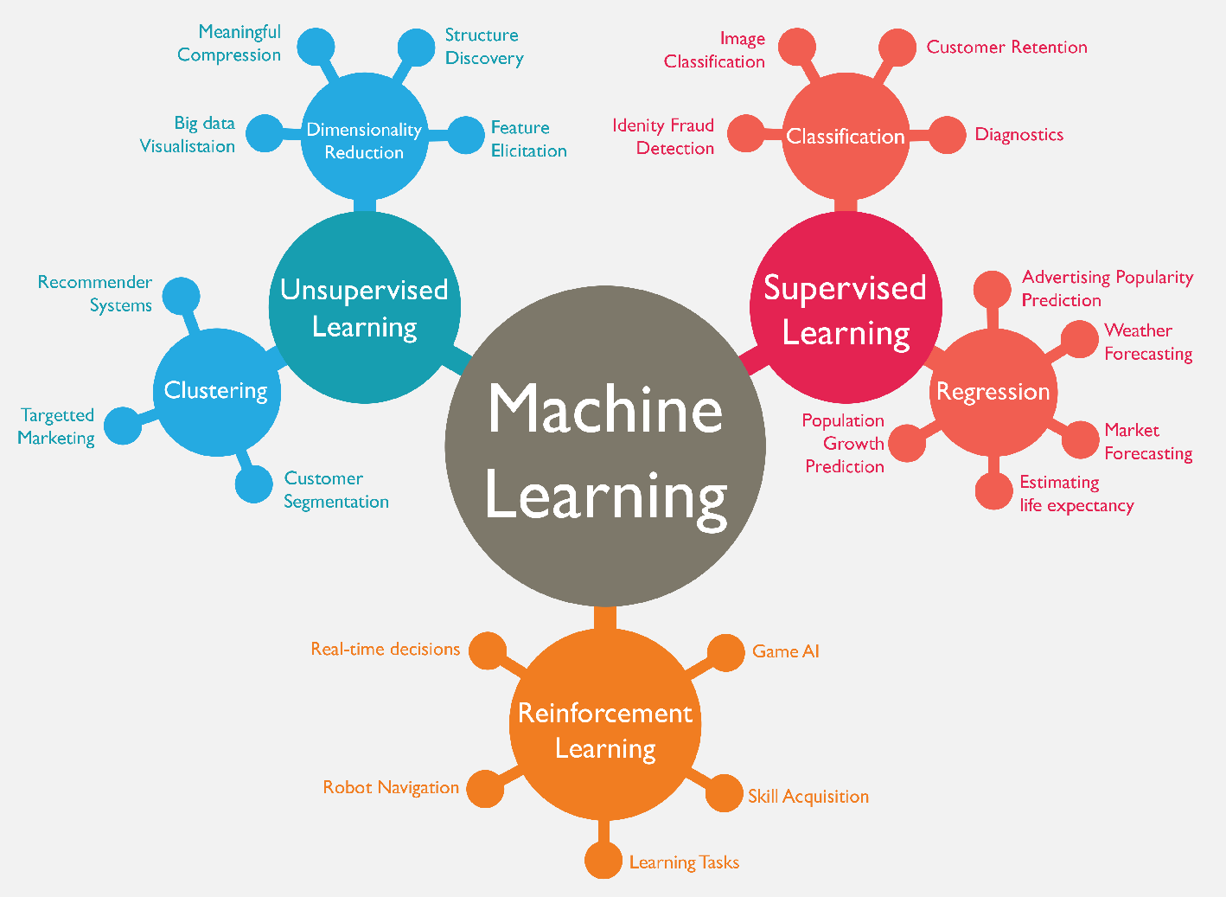
Machine Learning (ML)
Source: https://www.mactores.com/services/aws-big-data-machine-learning-cognitive-services/

Slide 26
Cloud Computing Architecture for Artificial Intelligence

Slide 27
Cloud Computing Architecture for AI Machine Learning
Lots of data
Computation / Algorithms
Knowledge
Source: https://acloudguru.com/blog/engineering/aws-vs-azure-vs-gcp-artificial-intelligence-and-machine-learning

Slide 28
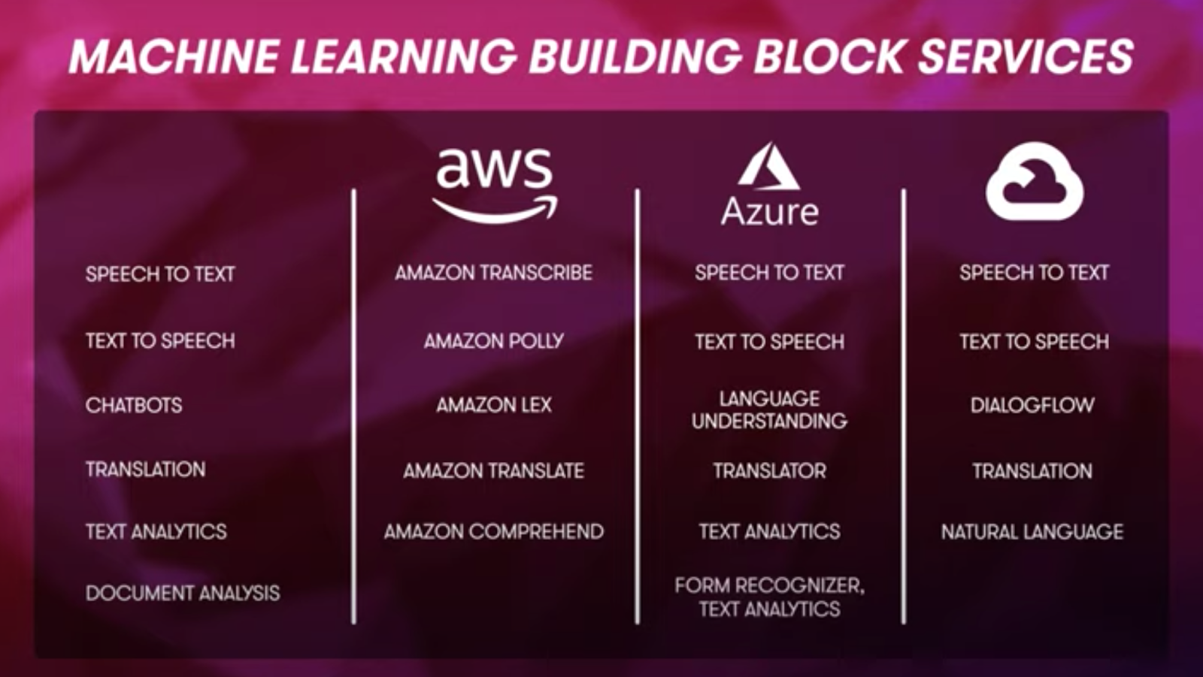
Artificial Intelligence and Machine Learning: AWS vs Azure vs GCP
Source: https://acloudguru.com/blog/engineering/aws-vs-azure-vs-gcp-artificial-intelligence-and-machine-learning

Slide 29
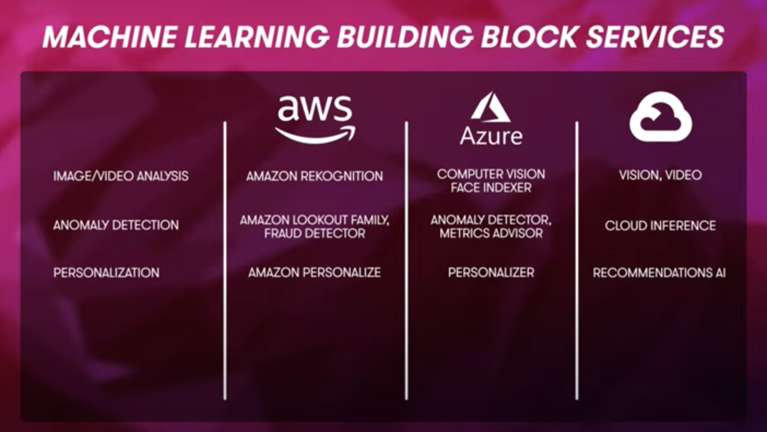
Artificial Intelligence and Machine Learning: AWS vs Azure vs GCP
Source: https://acloudguru.com/blog/engineering/aws-vs-azure-vs-gcp-artificial-intelligence-and-machine-learning

Slide 30
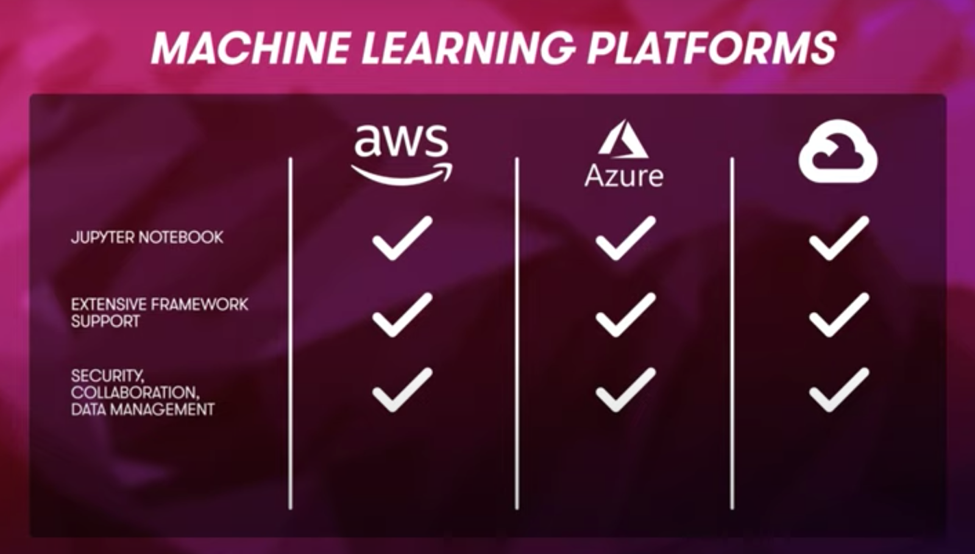
Artificial Intelligence and Machine Learning: AWS vs Azure vs GCP
Source: https://acloudguru.com/blog/engineering/aws-vs-azure-vs-gcp-artificial-intelligence-and-machine-learning

Slide 31
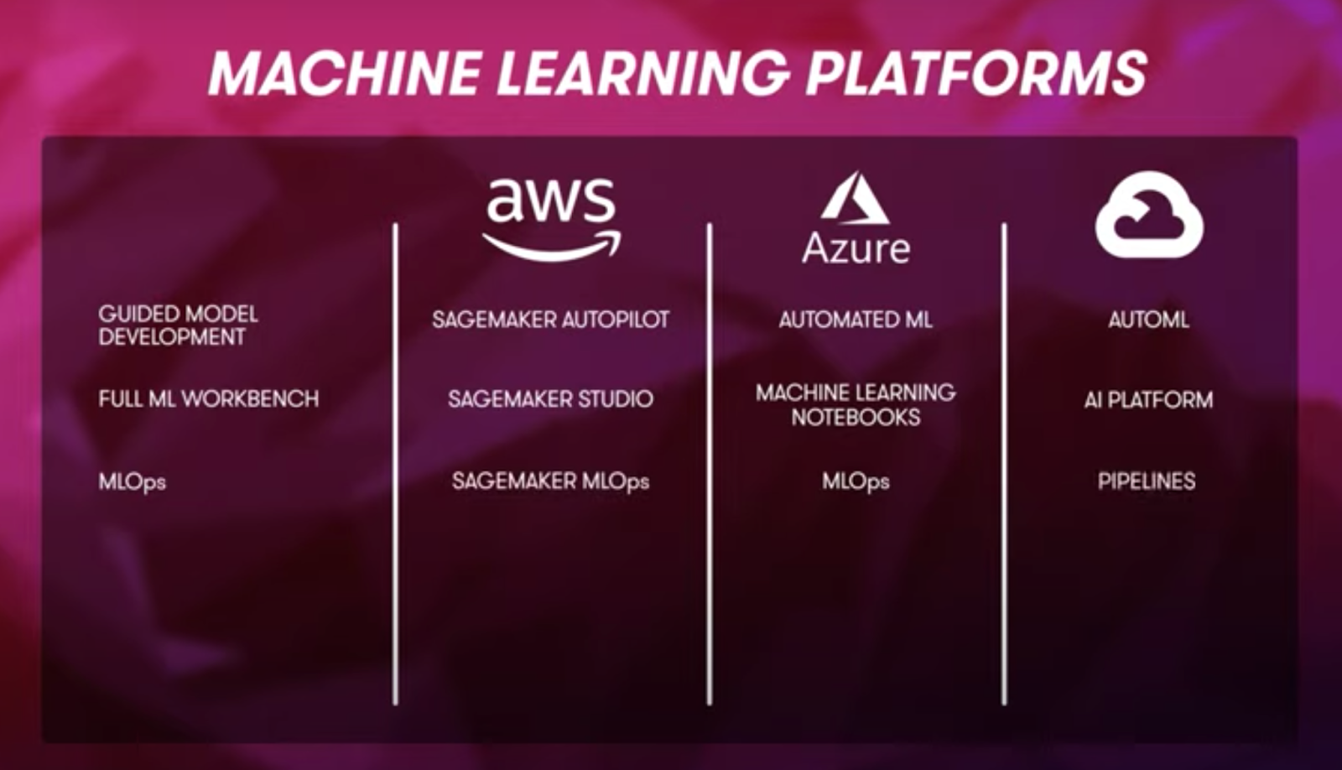
Artificial Intelligence and Machine Learning: AWS vs Azure vs GCP
Source: https://acloudguru.com/blog/engineering/aws-vs-azure-vs-gcp-artificial-intelligence-and-machine-learning

Slide 32
Machine learning building block services
Speech to text and text to speech
Chatbots
Translation
Text Analytics
Document Analysis
Image and video analysis
Anomaly detection
Personalization
Source: https://acloudguru.com/blog/engineering/aws-vs-azure-vs-gcp-artificial-intelligence-and-machine-learning

Slide 33
Machine learning platforms
Guided model development
Full ML workbench
MLOps
Augmented AI
AWS Augmented AI (Amazon A2I)
The power of real, living, breathing humans to help improve your machine learning service
Source: https://acloudguru.com/blog/engineering/aws-vs-azure-vs-gcp-artificial-intelligence-and-machine-learning

Slide 34
Machine Learning Infrastructure
Hardware
AWS: Habana Gaudi ASIC instances, custom processor AWS Trainium, optimized for model training. Inferentia for machine learning inferences.
Azure: FPGA-based virtual machines tuned specifically for machine learning workloads.
GCP: Tensor Processing Unit (TPU), ASIC-optimized for the TensorFlow framework.
Machine learning explainability and bias
AWS: SageMaker Clarify
Azure: Responsible ML and Fairlearn SDK
GCP: AI Explanations
Source: https://acloudguru.com/blog/engineering/aws-vs-azure-vs-gcp-artificial-intelligence-and-machine-learning

Slide 35

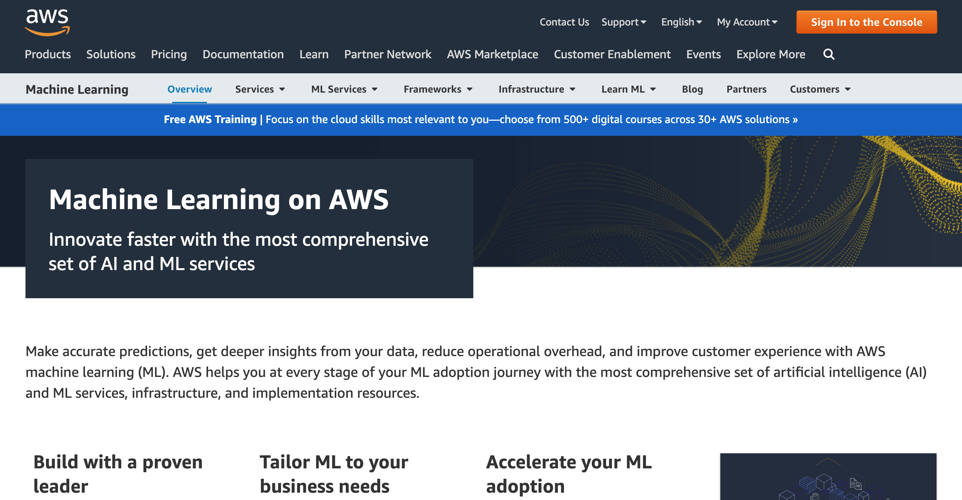
AWS Machine Learning
Source: https://aws.amazon.com/

Slide 36
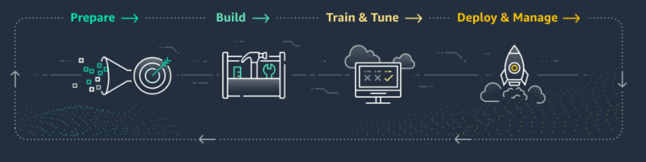
AWS Machine Learning Amazon SageMaker
Amazon SageMaker is an ML service enabling data scientists, data engineers, MLOps engineers, and business analysts to build, train, and deploy ML models for any use case, regardless of ML expertise.
Source: https://aws.amazon.com/machine-learning/

Slide 37
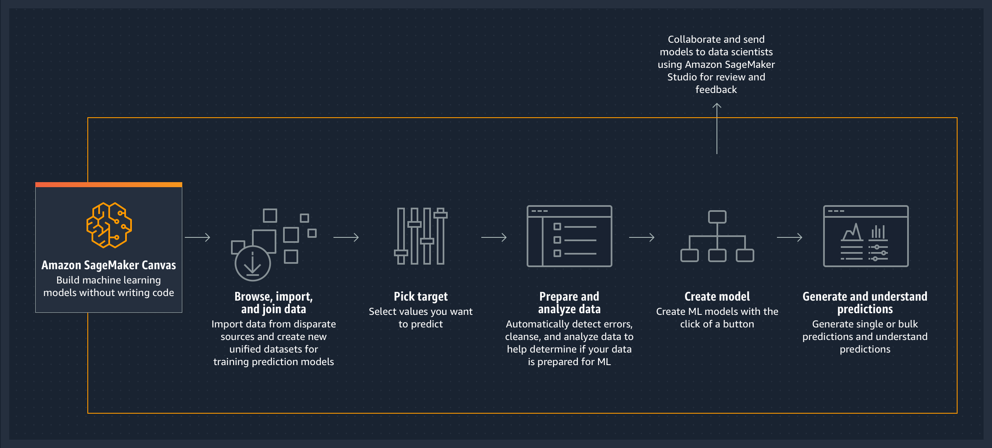
Amazon SageMaker for Business Analysts Amazon SageMaker Canvas
Amazon SageMaker is an ML service enabling data scientists, data engineers, MLOps engineers, and business analysts to build, train, and deploy ML models for any use case, regardless of ML expertise.
Source: https://aws.amazon.com/sagemaker/business-analyst/

Slide 38
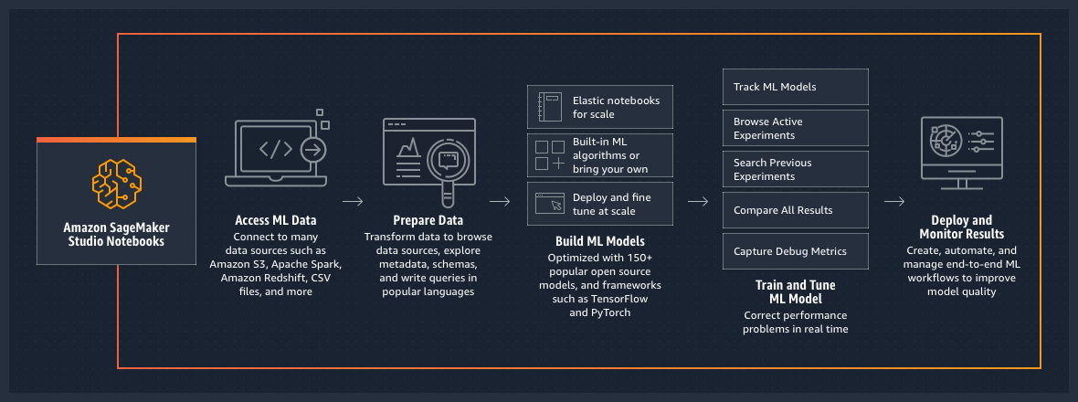
Amazon SageMaker for Data Scientists Amazon SageMaker Studio Notebooks
Source: https://aws.amazon.com/sagemaker/data-scientist/

Slide 39
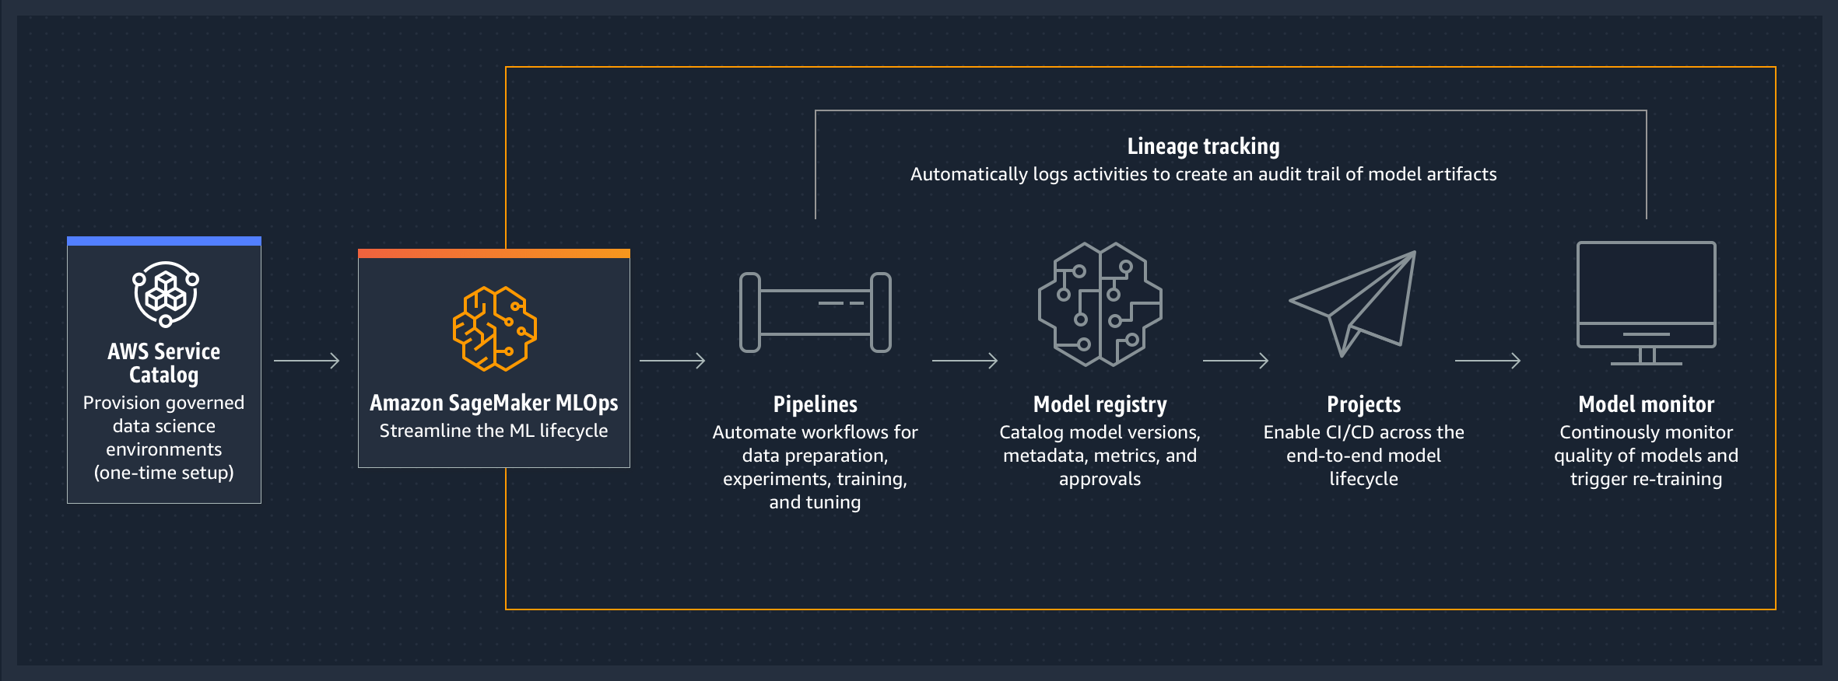
Amazon SageMaker for ML Engineers Amazon SageMaker MLOps
Source: https://aws.amazon.com/sagemaker/mlops/

Slide 40
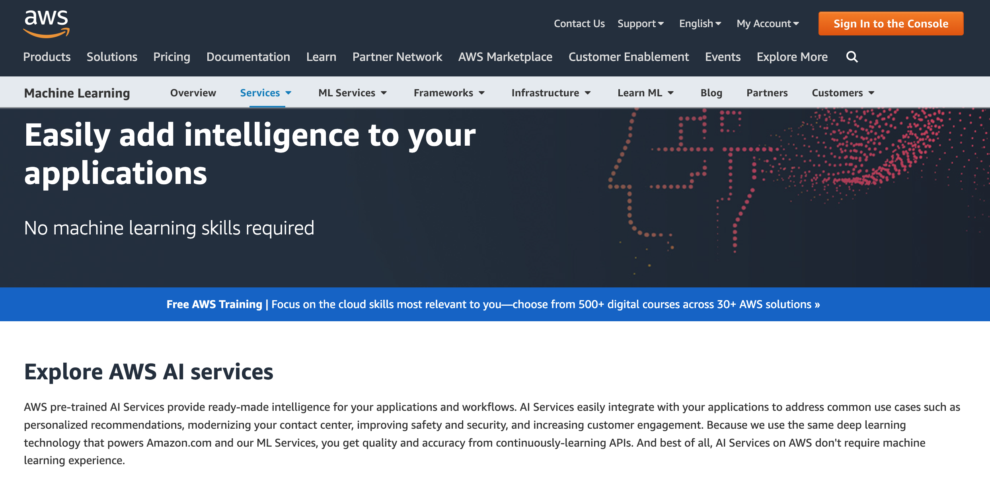
AWS Machine Learning AI Services
Source: https://aws.amazon.com/machine-learning/ai-services/

Slide 41
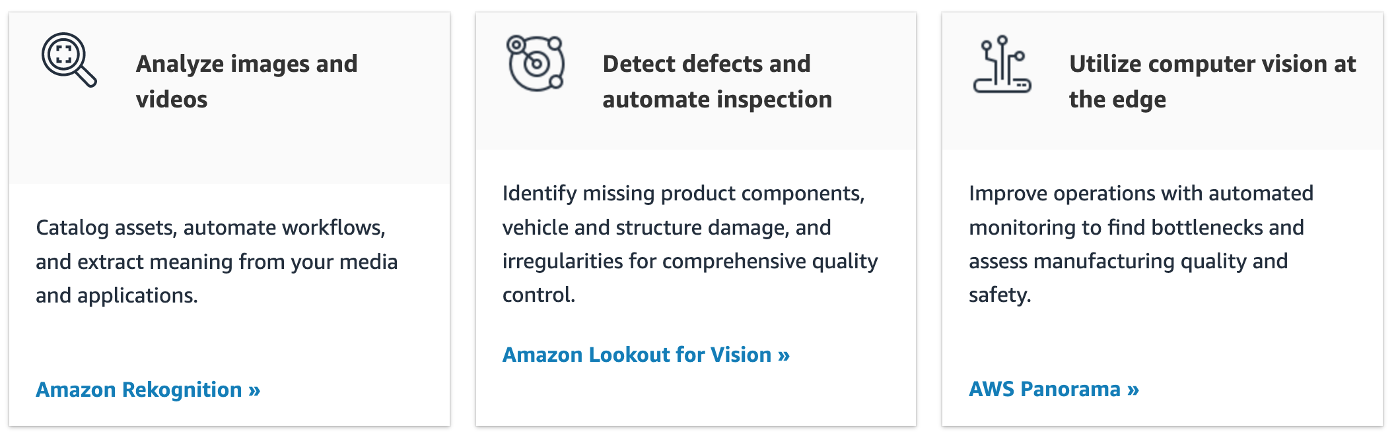
AWS Machine Learning AI Services Computer vision
Source: https://aws.amazon.com/machine-learning/ai-services/

Slide 42
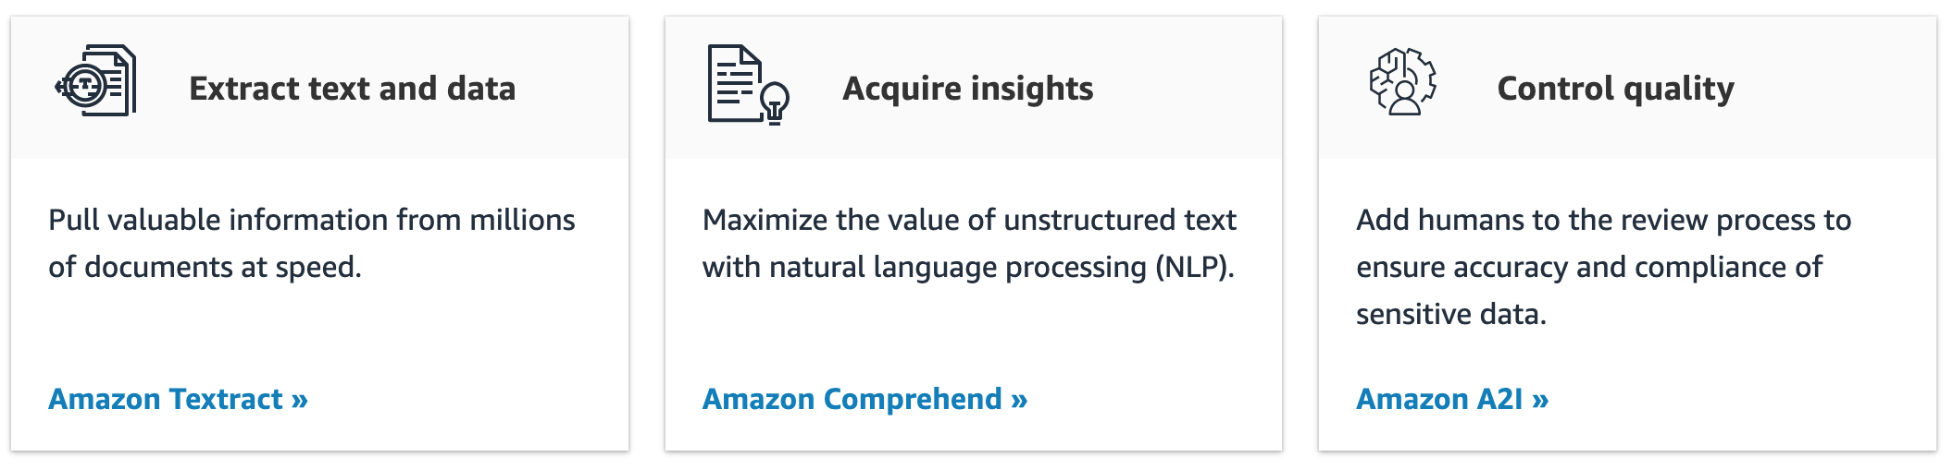
AWS Machine Learning AI Services Automated data extraction and analysis
Source: https://aws.amazon.com/machine-learning/ai-services/

Slide 43
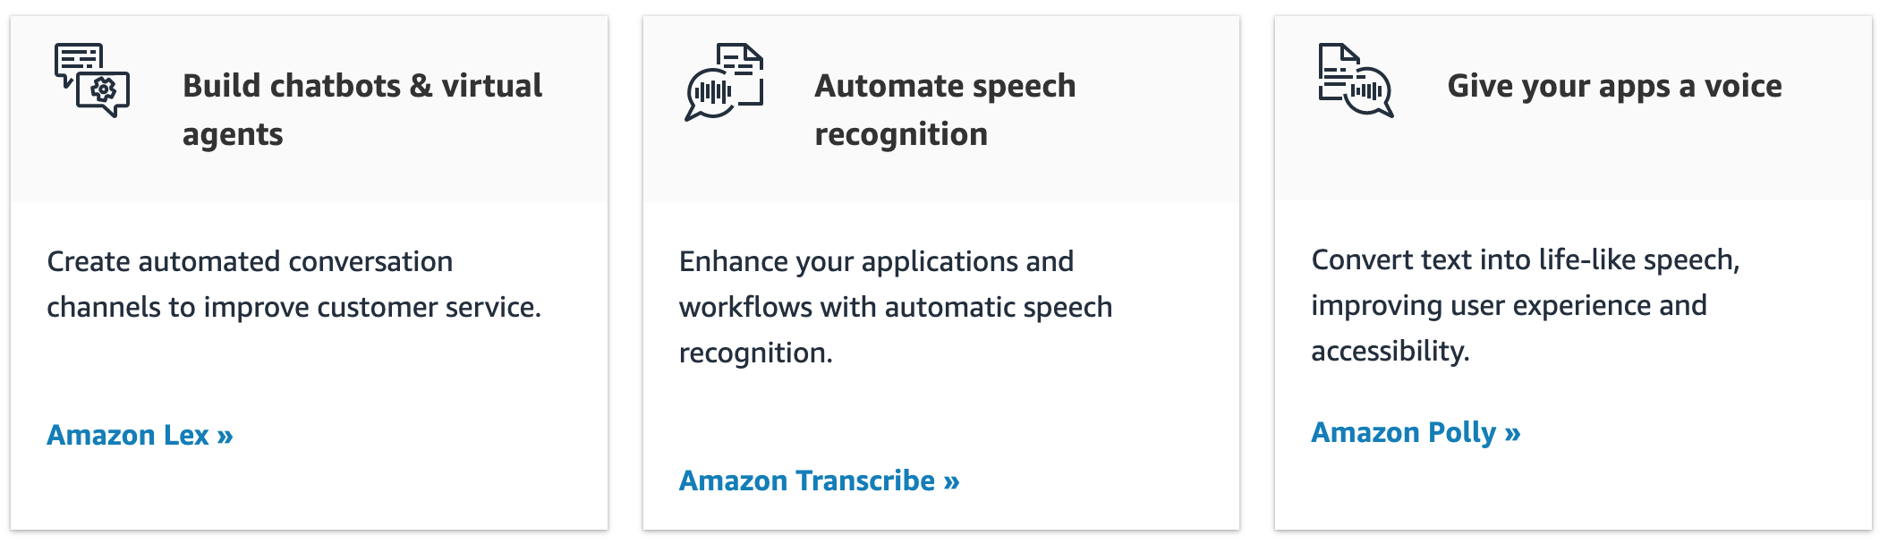
AWS Machine Learning AI Services Language AI
Source: https://aws.amazon.com/machine-learning/ai-services/

Slide 44
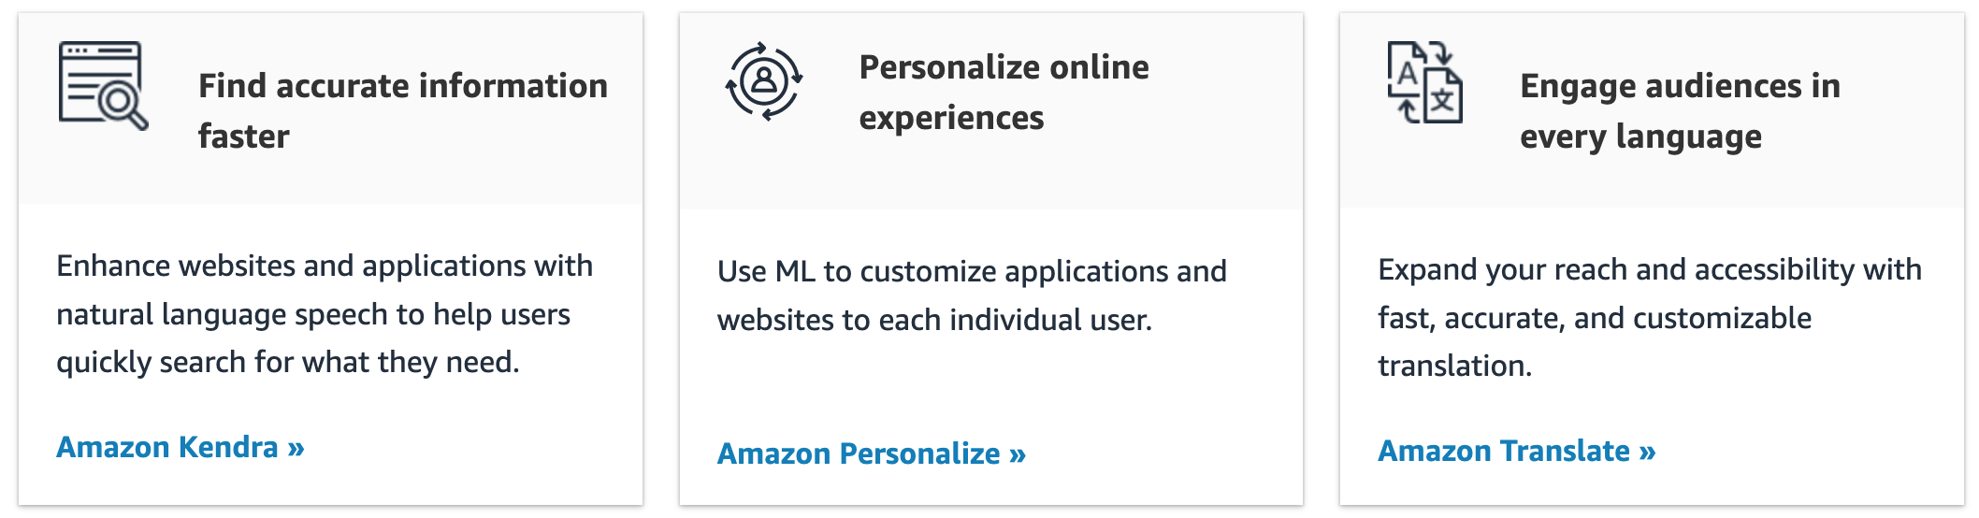
AWS Machine Learning AI Services Improve customer experience
Source: https://aws.amazon.com/machine-learning/ai-services/

Slide 45
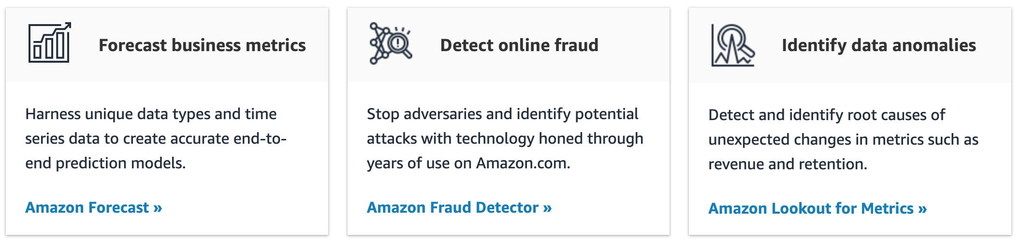
AWS Machine Learning AI Services Business metrics
Source: https://aws.amazon.com/machine-learning/ai-services/

Slide 46
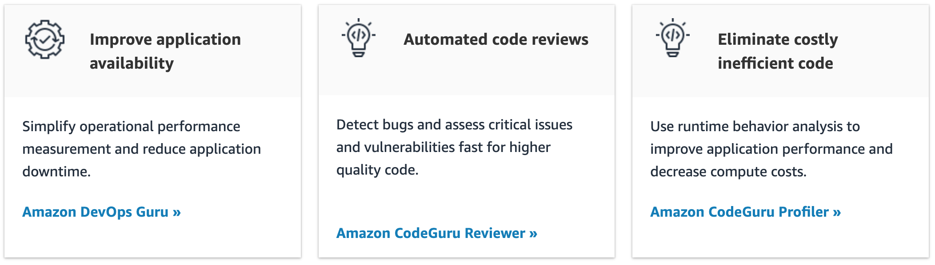
AWS Machine Learning AI Services Code and DevOps
Source: https://aws.amazon.com/machine-learning/ai-services/

Slide 47
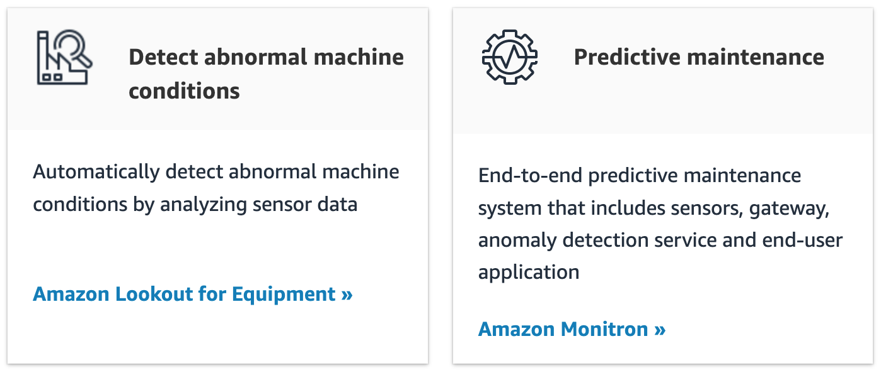
AWS Machine Learning AI Services Industrial AI
Source: https://aws.amazon.com/machine-learning/ai-services/

Slide 48
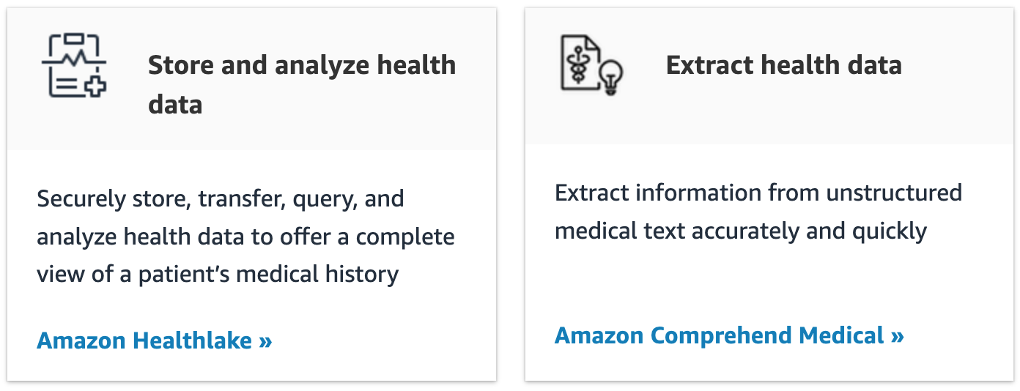
AWS Machine Learning AI Services Healthcare
Source: https://aws.amazon.com/machine-learning/ai-services/

Slide 49
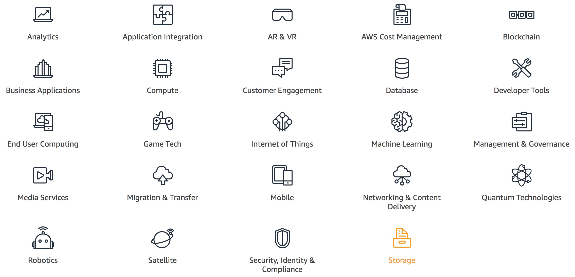
AWS Products and Services
Source: https://aws.amazon.com/

Slide 50
AWS Services
Amazon EC2
Virtual servers in the cloud
Amazon Simple Storage Service (S3)
Scalable storage in the cloud
Amazon Aurora
High performance managed relational database
Amazon DynamoDB
Managed NoSQL database
Amazon RDS
Managed relational database service for MySQL, PostgreSQL, Oracle, SQL Server, and MariaDB
Source: https://aws.amazon.com/

Slide 51
AWS Services
AWS Lambda
Run code without thinking about servers
AWS Elastic Beanstalk
Run and manage web apps
Amazon VPC
Isolated cloud resources
Amazon Lightsail
Launch and manage virtual private servers
Amazon SageMaker
Build, train, and deploy machine learning models at scale
Source: https://aws.amazon.com/

Slide 52
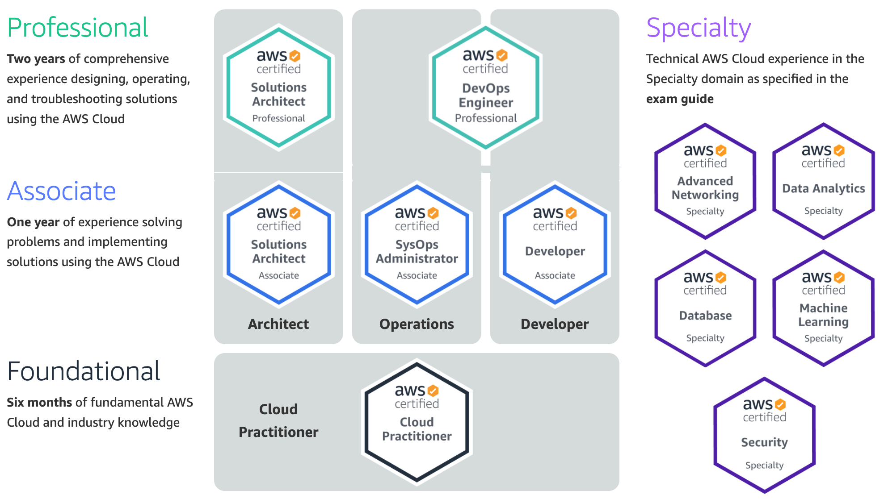
Available AWS Certifications
3
SAP
DA
2
SAA
ML
1
CLF
https://aws.amazon.com/certification/

Slide 53
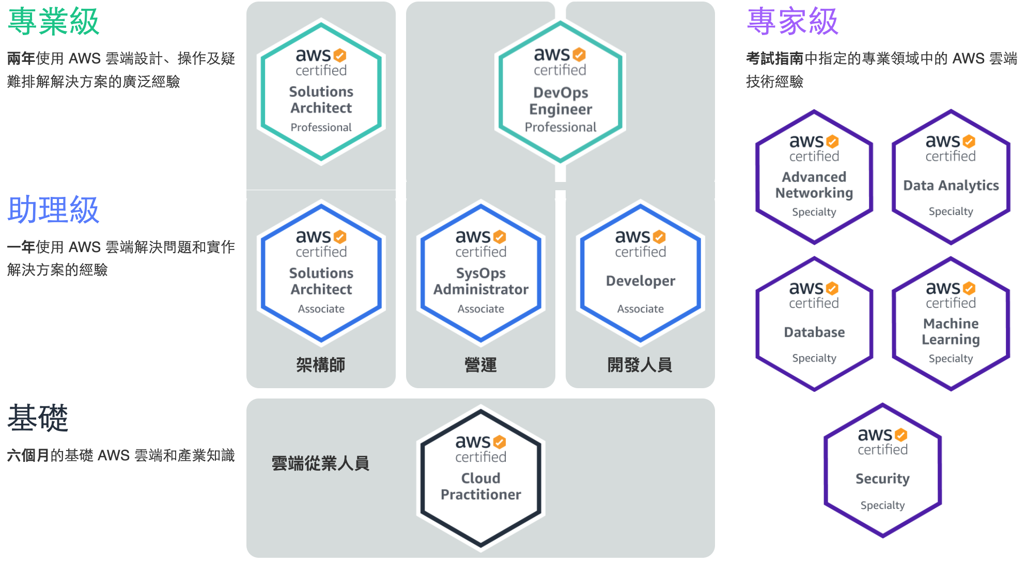
Available AWS Certifications
3
SAP
DA
2
ML
SAA
1
CLF
https://aws.amazon.com/certification/

Slide 54
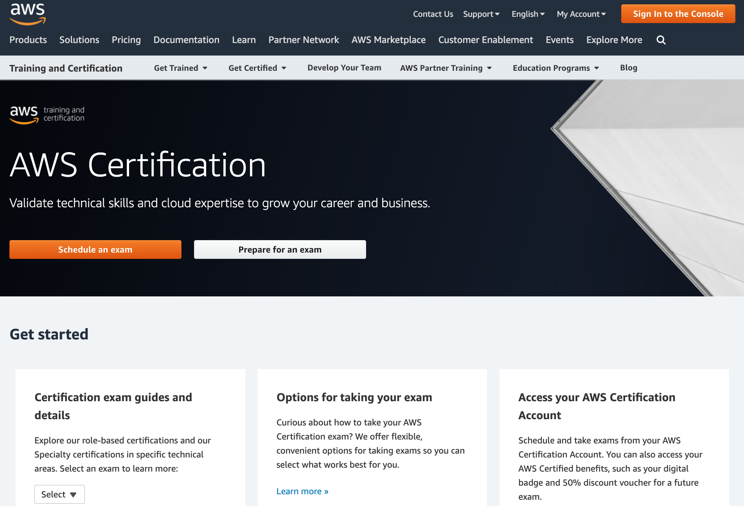
AWS Certification
https://aws.amazon.com/certification/

Slide 55
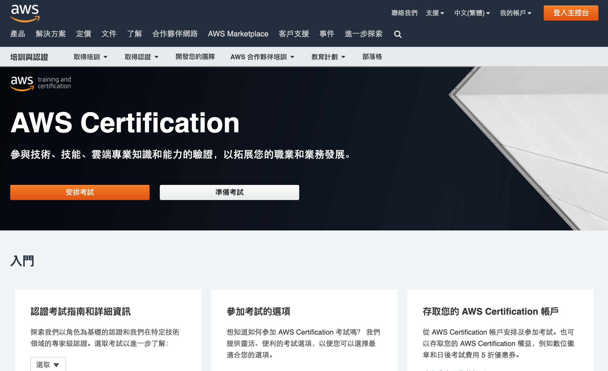
AWS Certification
https://aws.amazon.com/certification/

Slide 56
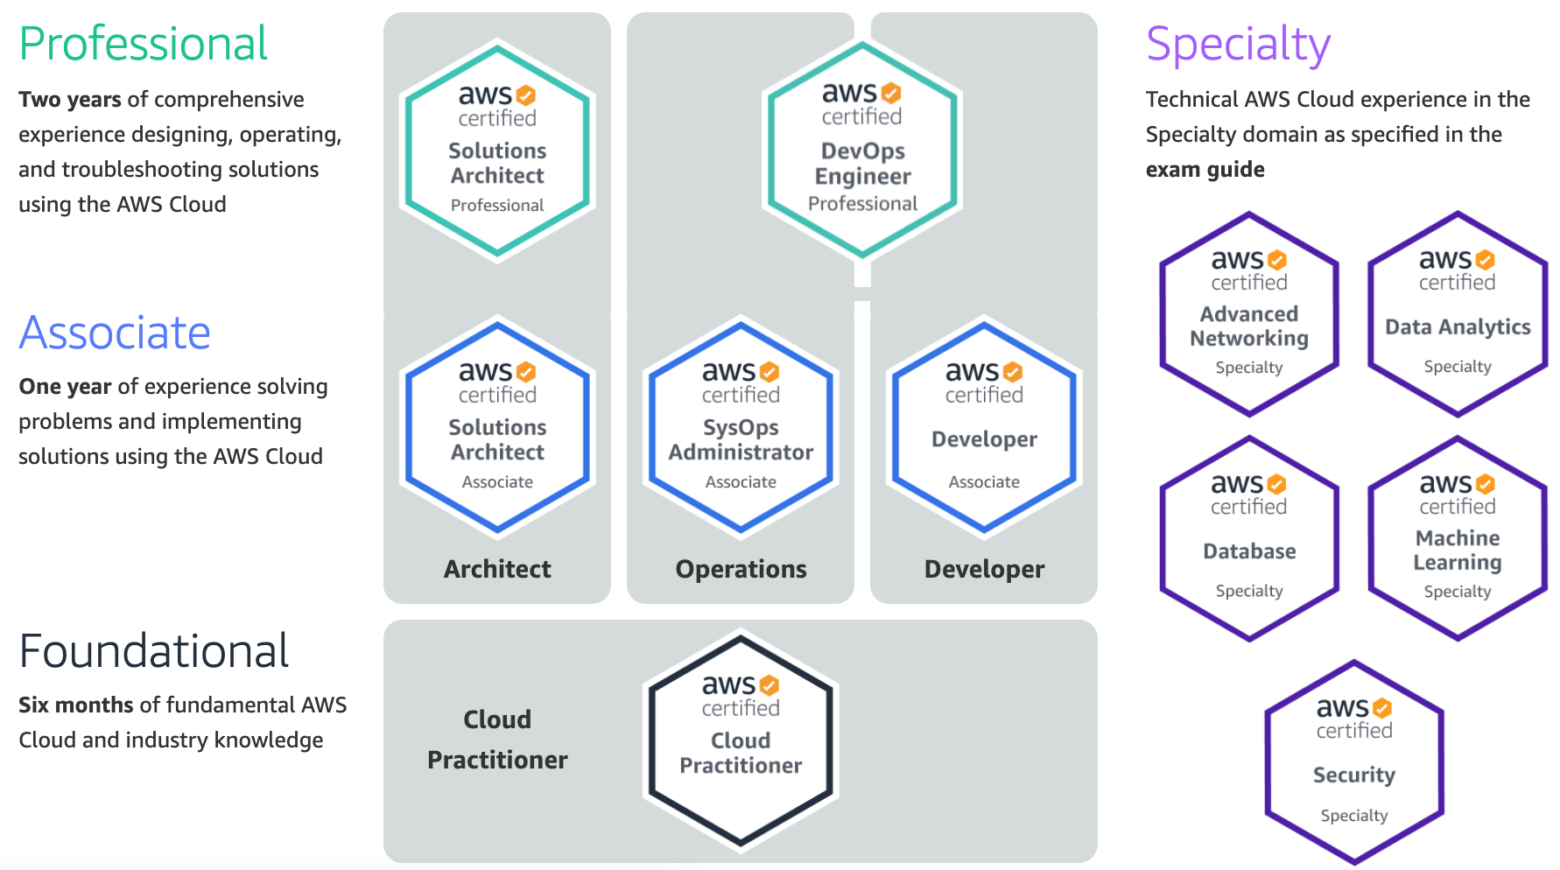
AWS Certification
2
SAA
1
CLF
https://aws.amazon.com/certification/

Slide 57
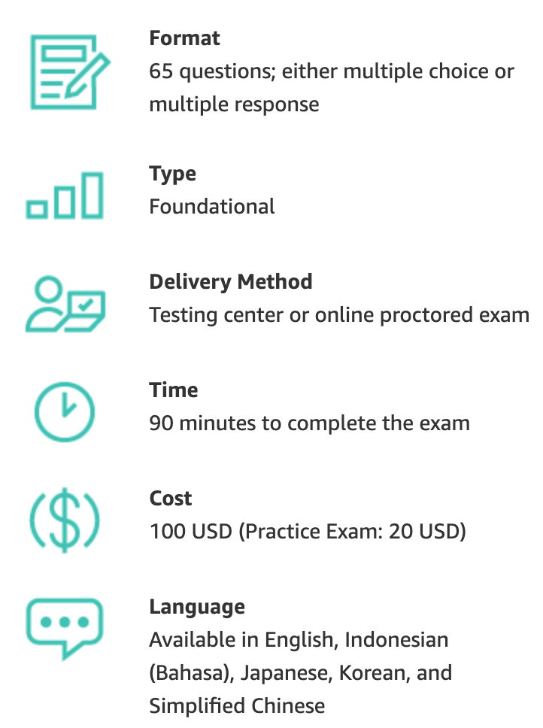
AWS Certification
https://aws.amazon.com/certification/

Slide 58
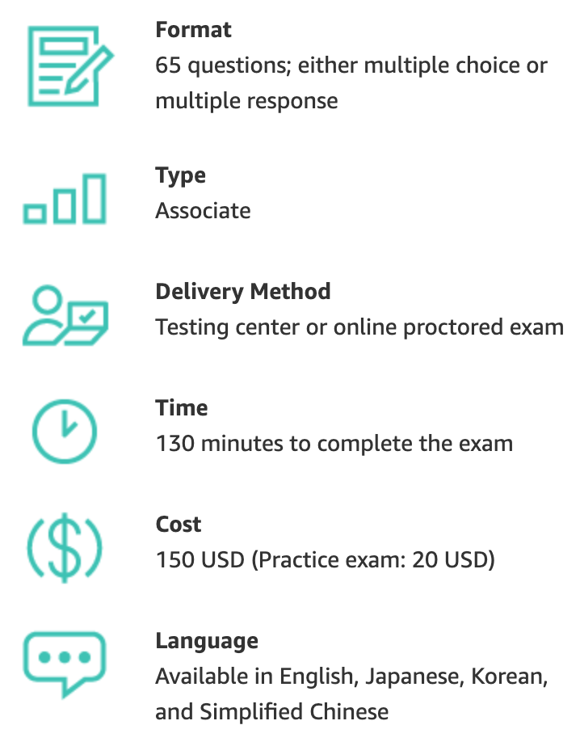
AWS Certification
https://aws.amazon.com/certification/

Slide 59
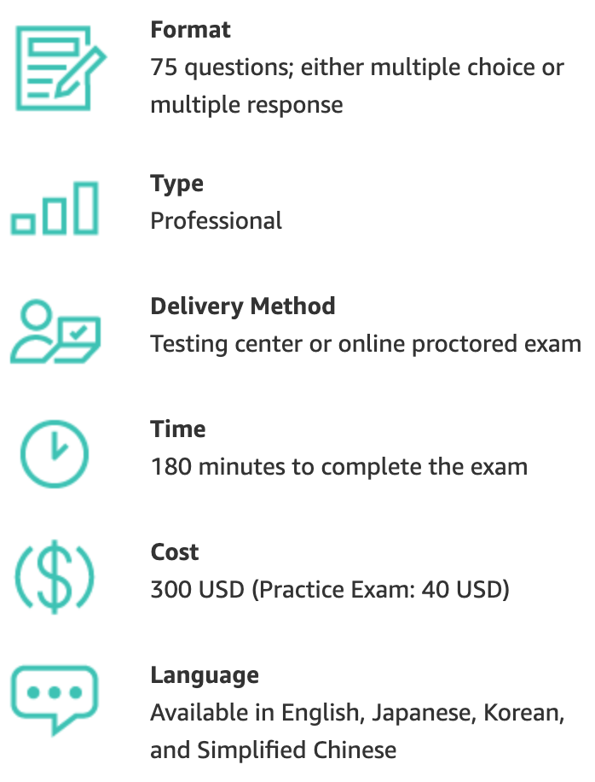
AWS Certification
https://aws.amazon.com/certification/

Slide 60
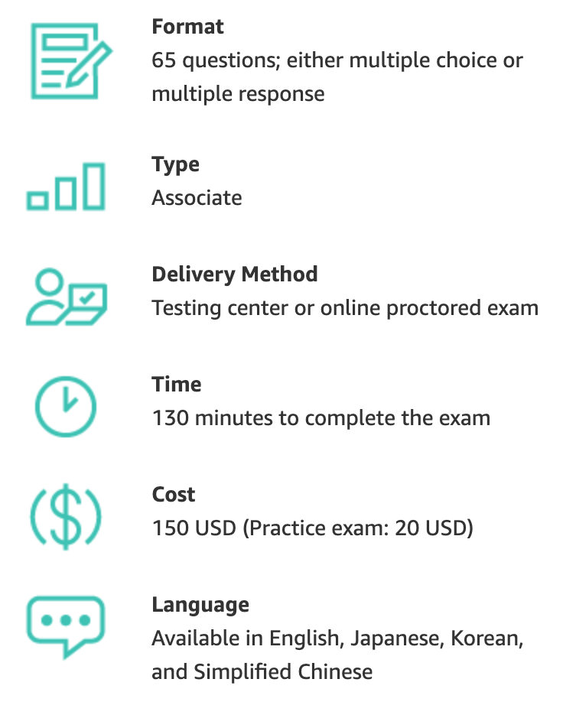
AWS Certification
https://aws.amazon.com/certification/

Slide 61
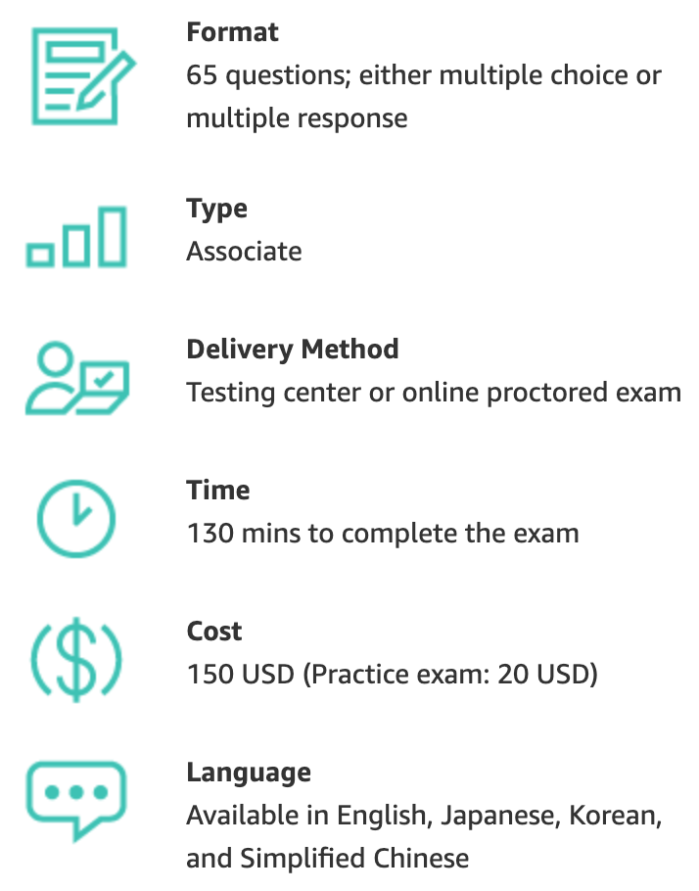
AWS Certification
https://aws.amazon.com/certification/

Slide 62
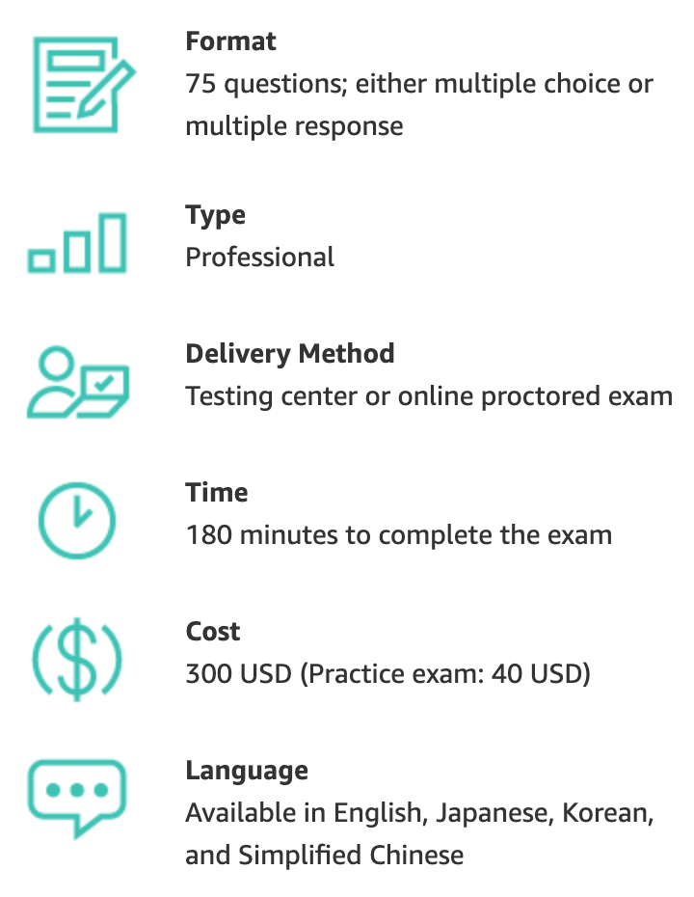
AWS Certification
https://aws.amazon.com/certification/

Slide 63
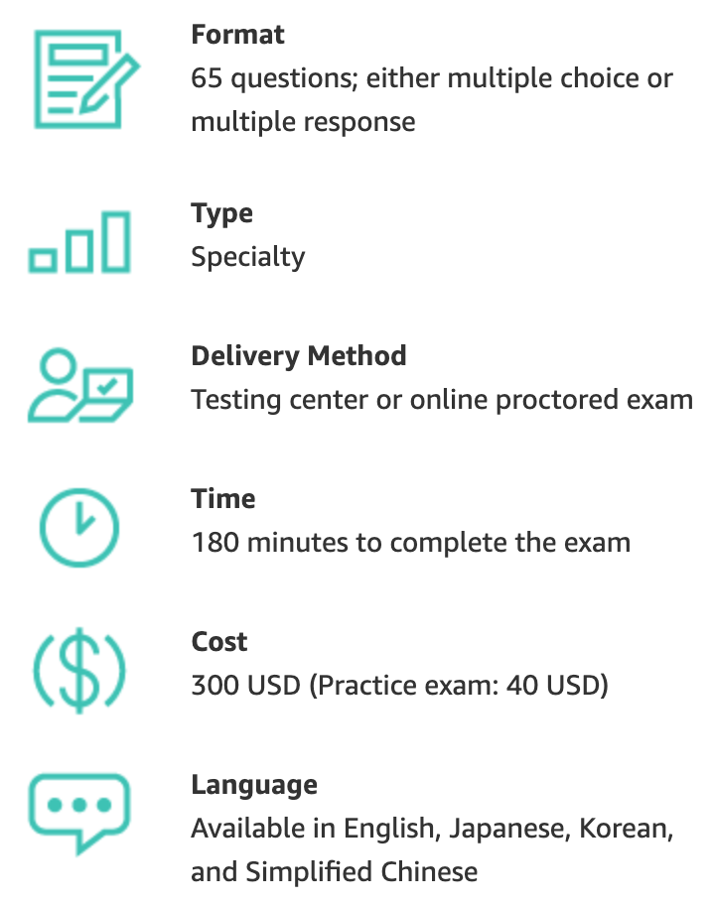
AWS Certification
https://aws.amazon.com/certification/

Slide 64
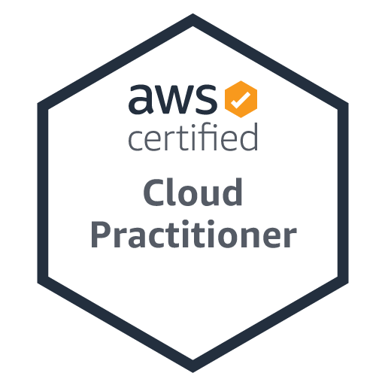
AWS Certified Cloud Practitioner
Level: Foundational
Length: 90 minutes to complete the exam
Cost: 100 USD
Format: 65 questions; either multiple choice or multiple response
Delivery method: Pearson VUE and PSI; testing center or online proctored exam
https://aws.amazon.com/certification/certified-cloud-practitioner/

Slide 65
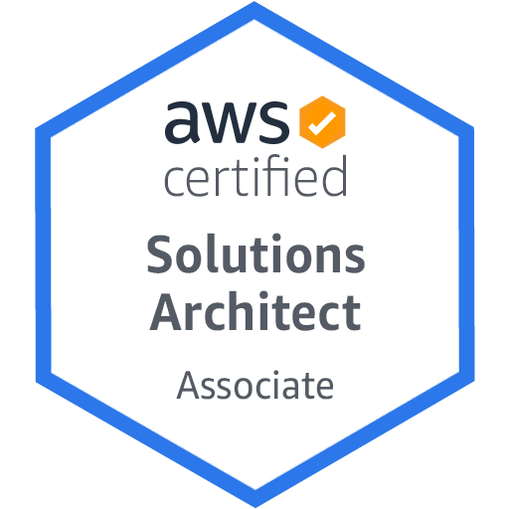
AWS Certified Solutions Architect – Associate
Level: Associate
Length: 130 minutes to complete the exam
Cost: 150 USD
Format: 65 questions; either multiple choice or multiple response
Delivery method: Pearson VUE and PSI; testing center or online proctored exam
https://aws.amazon.com/certification/certified-solutions-architect-associate/

Slide 66
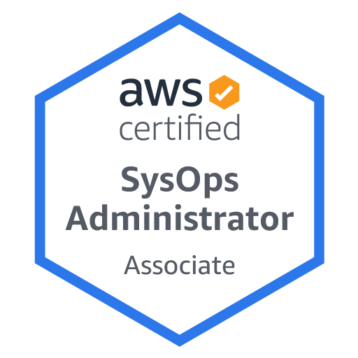
AWS Certified SysOps Administrator - Associate
Level: Associate
Length: 180 minutes to complete the exam
Cost: 150 USD
Format: 65 scoring opportunities that may be multiple choice, multiple response, or exam lab
Delivery method: Pearson VUE and PSI; testing center or online proctored exam
https://aws.amazon.com/certification/certified-sysops-admin-associate

Slide 67
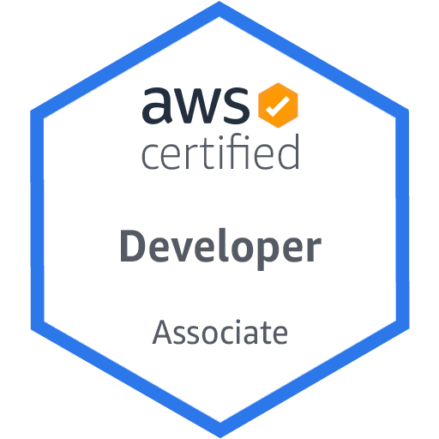
AWS Certified Solutions Architect – Associate
Level: Associate
Length: 130 minutes to complete the exam
Cost: 150 USD
Format: 65 questions; either multiple choice or multiple response
Delivery method: Pearson VUE and PSI; testing center or online proctored exam
https://aws.amazon.com/certification/certified-developer-associate

Slide 68
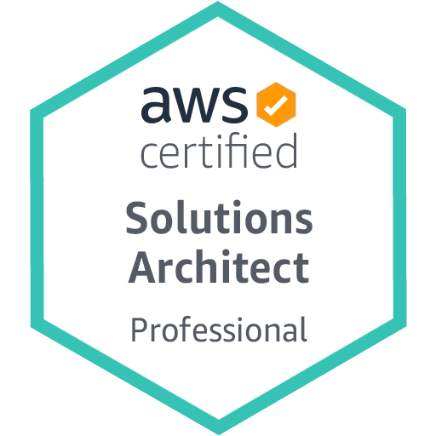
AWS Certified Solutions Architect - Professional
Level: Professional
Length: 180 minutes to complete the exam
Cost: 300 USD
Format: 75 questions; either multiple choice or multiple response
Delivery method: Pearson VUE and PSI; testing center or online proctored exam
https://aws.amazon.com/certification/certified-solutions-architect-professional

Slide 69
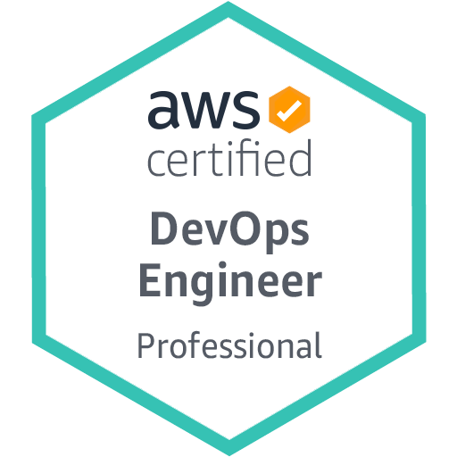
AWS Certified DevOps Engineer - Professional
Level: Professional
Length: 180 minutes to complete the exam
Cost: 300 USD
Format: 75 questions; either multiple choice or multiple response
Delivery method: Pearson VUE and PSI; testing center or online proctored exam
https://aws.amazon.com/certification/certified-devops-engineer-professional

Slide 70
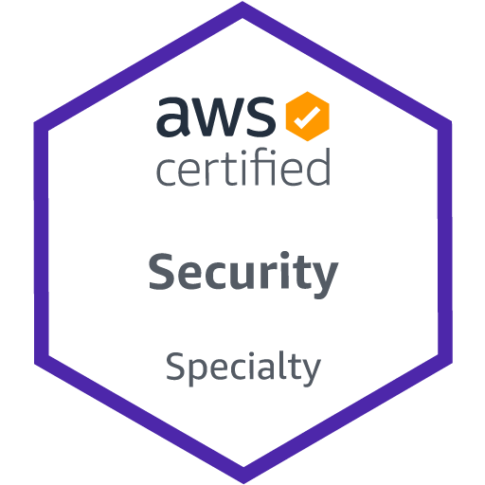
AWS Certified Security - Specialty
Level: Specialty
Length: 170 minutes to complete the exam
Cost: 300 USD
Format: 65 questions; either multiple choice or multiple response
Delivery method: Pearson VUE and PSI; testing center or online proctored exam
https://aws.amazon.com/certification/certified-security-specialty

Slide 71
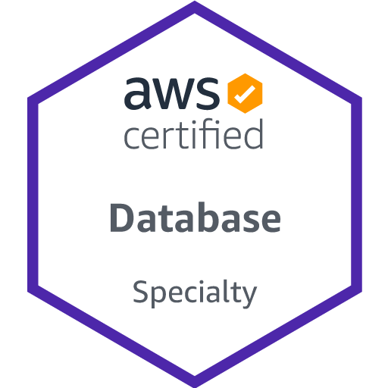
AWS Certified Database - Specialty
Level: Specialty
Length: 180 minutes to complete the exam
Cost: 300 USD
Format: 65 questions; either multiple choice or multiple response
Delivery method: Pearson VUE and PSI; testing center or online proctored exam
https://aws.amazon.com/certification/certified-database-specialty

Slide 72
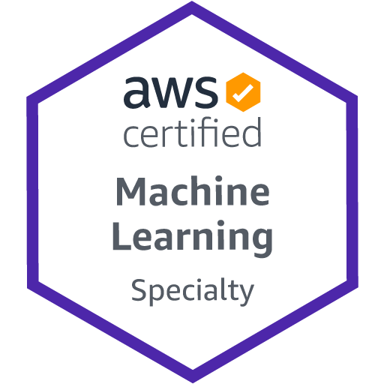
AWS Certified Machine Learning – Specialty
Level: Specialty
Length: 180 minutes to complete the exam
Cost: 300 USD
Format: 65 questions; either multiple choice or multiple response
Delivery method: Pearson VUE and PSI; testing center or online proctored exam
https://aws.amazon.com/certification/certified-machine-learning-specialty/

Slide 73
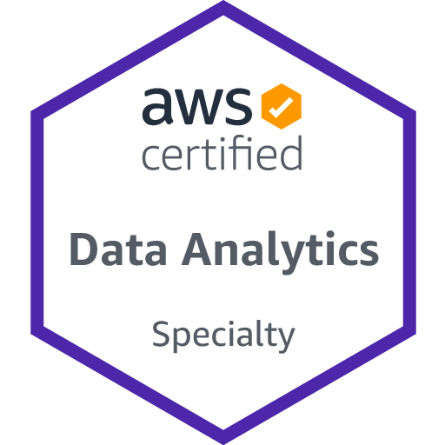
AWS Certified Data Analytics - Specialty
Level: Specialty
Length: 180 minutes to complete the exam
Cost: 300 USD
Format: 65 questions; either multiple choice or multiple response
Delivery method: Pearson VUE and PSI; testing center or online proctored exam
https://aws.amazon.com/certification/certified-data-analytics-specialty

Slide 74
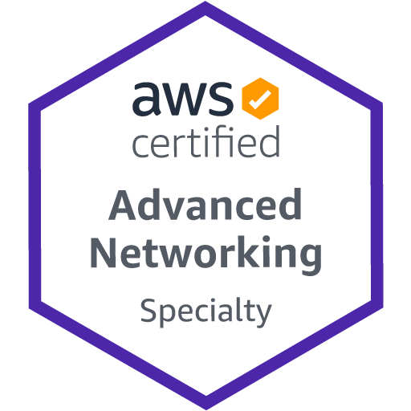
AWS Certified Advanced Networking - Specialty
Level: Specialty
Length: 170 minutes to complete the exam
Cost: 300 USD
Format: 65 questions; either multiple choice or multiple response
Delivery method: Pearson VUE and PSI; testing center or online proctored exam
https://aws.amazon.com/certification/certified-advanced-networking-specialty

Slide 75
AWS Certifications Roadmap
https://aws.amazon.com/certification/

Slide 76
AWS Certifications Roadmap Cloud Architect
https://aws.amazon.com/certification/

Slide 77
AWS Certifications Roadmap Cloud Developer
https://aws.amazon.com/certification/

Slide 78
AWS Certifications Roadmap DevOps
https://aws.amazon.com/certification/

Slide 79
AWS Certifications Roadmap Data Analytics / Machine Learning
https://aws.amazon.com/certification/

Slide 80
AWS Certifications Roadmap Security
https://aws.amazon.com/certification/

Slide 81
AWS Certified Cloud Practitioner (CLF-C01)
Source: https://aws.amazon.com/certification/certified-cloud-practitioner/

Slide 82
AWS Certified Cloud Practitioner
This certification provides individuals in a larger variety of cloud and technology roles with a way to validate their AWS Cloud knowledge and enhance their professional credibility.
This exam covers four domains, including cloud concepts, security, technology, and billing and pricing.
https://aws.amazon.com/certification/certified-cloud-practitioner/

Slide 83
AWS Certified Solutions Architect – Associate (SAA-C02)
Source: https://aws.amazon.com/certification/certified-solutions-architect-associate

Slide 84
AWS Certified Solutions Architect – Associate
This certification validates your ability to effectively demonstrate knowledge of how to architect and deploy secure and robust applications on AWS technologies.
This exam is for anyone with at least one year of hands-on experience designing available, cost-efficient, fault-tolerant, and scalable and distributed systems on AWS.
https://aws.amazon.com/certification/certified-solutions-architect-associate/

Slide 85
AWS Academy and Certifications
1
AWS Academy Cloud Foundations (ACF)
AWS Certified Cloud Practitioner (CLF-C01)
https://aws.amazon.com/certification/certified-cloud-practitioner/
AWS Academy Cloud Architecting (ACA)
AWS Certified Solutions Architect – Associate (SAA-C02)
https://aws.amazon.com/certification/certified-solutions-architect-associate/
2
https://aws.amazon.com/training/awsacademy/

Slide 86
AWS Certified Cloud Practitioner (CLF-C01)
Domain | % of Examination
Domain 1: Cloud Concepts | 26%
Domain 2: Security and Compliance | 25%
Domain 3: Technology | 33%
Domain 4: Billing and Pricing | 16%
TOTAL | 100%
Source: https://aws.amazon.com/certification/certified-cloud-practitioner/

Slide 87
AWS Certified Solutions Architect – Associate (SAA-C02)
Domain | % of Examination
Domain 1: Design Resilient Architectures | 30%
Domain 2: Design High-Performing Architectures | 28%
Domain 3: Specify Secure Applications and Architectures | 24%
Domain 4: Design Cost-Optimized Architectures | 18%
TOTAL | 100%
Source: https://aws.amazon.com/certification/certified-solutions-architect-associate

Slide 88
AWS Certified Cloud Practitioner (CLF-C01)
Source: https://aws.amazon.com/certification/certified-cloud-practitioner/

Slide 89
AWS Certified Cloud Practitioner (CLF-C01)
Domain 1: Cloud Concepts
1.1 Define the AWS Cloud and its value proposition
1.2 Identify aspects of AWS Cloud economics
1.3 List the different cloud architecture design principles
Source: https://aws.amazon.com/certification/certified-cloud-practitioner/

Slide 90
AWS Certified Cloud Practitioner (CLF-C01)
Domain 2: Security and Compliance
2.1 Define the AWS shared responsibility model
2.2 Define AWS Cloud security and compliance concepts
2.3 Identify AWS access management capabilities
2.4 Identify resources for security support
Source: https://aws.amazon.com/certification/certified-cloud-practitioner/

Slide 91
AWS Certified Cloud Practitioner (CLF-C01)
Domain 3: Technology
3.1 Define methods of deploying and operating in the AWS Cloud
3.2 Define the AWS global infrastructure
3.3 Identify the core AWS services
3.4 Identify resources for technology support
Source: https://aws.amazon.com/certification/certified-cloud-practitioner/

Slide 92
AWS Certified Cloud Practitioner (CLF-C01)
Domain 4: Billing and Pricing
4.1 Compare and contrast the various pricing models for AWS
4.2 Recognize the various account structures in relation to AWS billing and pricing
4.3 Identify resources available for billing support
Source: https://aws.amazon.com/certification/certified-cloud-practitioner/

Slide 93
AWS Certified Solutions Architect – Associate (SAA-C02)
Source: https://aws.amazon.com/certification/certified-solutions-architect-associate

Slide 94
AWS Certified Solutions Architect – Associate (SAA-C02)
Domain 1: Design Resilient Architectures
1.1 Design a multi-tier architecture solution
1.2 Design highly available and/or fault-tolerant architectures
1.3 Design decoupling mechanisms using AWS services
1.4 Choose appropriate resilient storage
Source: https://aws.amazon.com/certification/certified-solutions-architect-associate

Slide 95
AWS Certified Solutions Architect – Associate (SAA-C02)
Domain 2: Design High-Performing Architectures
2.1 Identify elastic and scalable compute solutions for a workload
2.2 Select high-performing and scalable storage solutions for a workload
2.3 Select high-performing networking solutions for a workload
2.4 Choose high-performing database solutions for a workload
Source: https://aws.amazon.com/certification/certified-solutions-architect-associate

Slide 96
AWS Certified Solutions Architect – Associate (SAA-C02)
Domain 3: Design Secure Applications and Architectures
3.1 Design secure access to AWS resources
3.2 Design secure application tiers
3.3 Select appropriate data security options
Source: https://aws.amazon.com/certification/certified-solutions-architect-associate

Slide 97
AWS Certified Solutions Architect – Associate (SAA-C02)
Domain 4: Design Cost-Optimized Architectures
4.1 Identify cost-effective storage solutions
4.2 Identify cost-effective compute and database services
4.3 Design cost-optimized network architectures
Source: https://aws.amazon.com/certification/certified-solutions-architect-associate

Slide 98
AWS Certifications Exam Pricing
Exam Type | Price in USD
Foundational | $100
Associate | $150
Professional | $300
Specialty | $300

Slide 99
Web Application with AWS Core Services

Slide 100
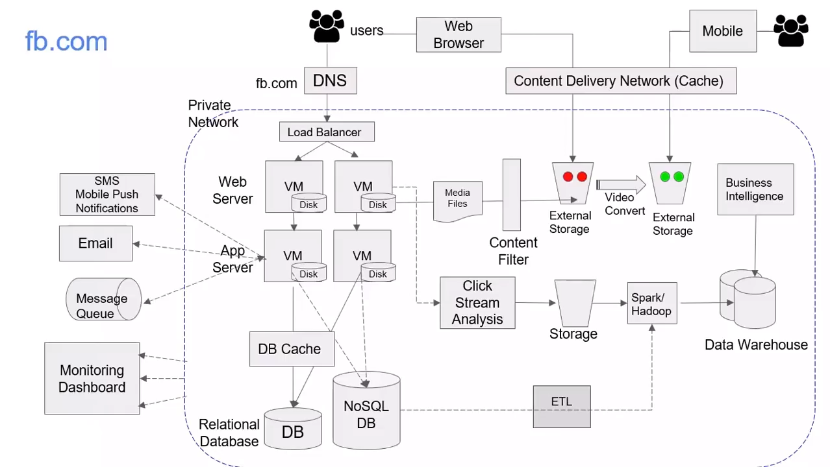
Source: AWS Training Center (2019), Introduction to AWS Services, https://youtu.be/Z3SYDTMP3ME

Slide 101

Source: AWS Training Center (2019), Introduction to AWS Services, https://youtu.be/Z3SYDTMP3ME

Slide 102
Source: AWS Training Center (2019), Introduction to AWS Services, https://youtu.be/Z3SYDTMP3ME

Slide 103
Source: AWS Training Center (2019), Introduction to AWS Services, https://youtu.be/Z3SYDTMP3ME

Slide 104

Source: AWS Training Center (2019), Introduction to AWS Services, https://youtu.be/Z3SYDTMP3ME

Slide 105

Source: AWS Training Center (2019), Introduction to AWS Services, https://youtu.be/Z3SYDTMP3ME

Slide 106

Source: AWS Training Center (2019), Introduction to AWS Services, https://youtu.be/Z3SYDTMP3ME

Slide 107
AWS Serverless Architecture

Slide 108

AWS Serverless Airline Booking
Source: https://github.com/aws-samples/aws-serverless-airline-booking

Slide 109

AWS Serverless Airline Booking Stack
Source: https://github.com/aws-samples/aws-serverless-airline-booking

Slide 110

AWS Serverless Airline Booking High level infrastructure architecture
Source: https://github.com/aws-samples/aws-serverless-airline-booking

Slide 111

AWS Serverless Architecture AWS Operational Responsibility Models
Source: Heitor Lessa (2019), How to build a full stack serverless airline ticketing web app, https://www.youtube.com/watch?v=MyoOeHTp2pg

Slide 112
Build a Serverless Web Application

Slide 113

Build a Serverless Web Application
Source: https://aws.amazon.com/getting-started/projects/build-serverless-web-app-lambda-apigateway-s3-dynamodb-cognito/

Slide 114

Build a Serverless Web Application with Amazon S3, AWS Lambda, Amazon API Gateway, Amazon DynamoDB, and Amazon Cognito
Source: https://aws.amazon.com/getting-started/projects/build-serverless-web-app-lambda-apigateway-s3-dynamodb-cognito/

Slide 115

Build a Serverless Web Application with Amazon S3, AWS Lambda, Amazon API Gateway, Amazon DynamoDB, and Amazon Cognito
1
Source: https://aws.amazon.com/getting-started/projects/build-serverless-web-app-lambda-apigateway-s3-dynamodb-cognito/

Slide 116
Build a Serverless Web Application with Amazon S3, AWS Lambda, Amazon API Gateway, Amazon DynamoDB, and Amazon Cognito
1
Static Web Hosting
Amazon S3 hosts static web resources including HTML, CSS, JavaScript, and image files which are loaded in the user's browser.
Source: https://aws.amazon.com/getting-started/projects/build-serverless-web-app-lambda-apigateway-s3-dynamodb-cognito/

Slide 117

Build a Serverless Web Application with Amazon S3, AWS Lambda, Amazon API Gateway, Amazon DynamoDB, and Amazon Cognito
2
Source: https://aws.amazon.com/getting-started/projects/build-serverless-web-app-lambda-apigateway-s3-dynamodb-cognito/

Slide 118
Build a Serverless Web Application with Amazon S3, AWS Lambda, Amazon API Gateway, Amazon DynamoDB, and Amazon Cognito
2
User Management
Amazon Cognito provides user management and authentication functions to secure the backend API.
Source: https://aws.amazon.com/getting-started/projects/build-serverless-web-app-lambda-apigateway-s3-dynamodb-cognito/

Slide 119

Build a Serverless Web Application with Amazon S3, AWS Lambda, Amazon API Gateway, Amazon DynamoDB, and Amazon Cognito
3
Source: https://aws.amazon.com/getting-started/projects/build-serverless-web-app-lambda-apigateway-s3-dynamodb-cognito/

Slide 120
Build a Serverless Web Application with Amazon S3, AWS Lambda, Amazon API Gateway, Amazon DynamoDB, and Amazon Cognito
3
Serverless Backend
Amazon DynamoDB provides a persistence layer where data can be stored by the API's Lambda function.
Source: https://aws.amazon.com/getting-started/projects/build-serverless-web-app-lambda-apigateway-s3-dynamodb-cognito/

Slide 121

Build a Serverless Web Application with Amazon S3, AWS Lambda, Amazon API Gateway, Amazon DynamoDB, and Amazon Cognito
4
Source: https://aws.amazon.com/getting-started/projects/build-serverless-web-app-lambda-apigateway-s3-dynamodb-cognito/

Slide 122
Build a Serverless Web Application with Amazon S3, AWS Lambda, Amazon API Gateway, Amazon DynamoDB, and Amazon Cognito
4
RESTful API
JavaScript executed in the browser sends and receives data from a public backend API built using Lambda and API Gateway.
Source: https://aws.amazon.com/getting-started/projects/build-serverless-web-app-lambda-apigateway-s3-dynamodb-cognito/

Slide 123
Build a Serverless Web Application with Amazon S3, AWS Lambda, Amazon API Gateway, Amazon DynamoDB, and Amazon Cognito
5
Terminate resources
Resource Cleanup
You will terminate an Amazon S3 bucket, an Amazon Cognito User Pool, an AWS Lambda function, an IAM role, a DynamoDB table, a REST API, and a CloudWatch Log. It is a best practice to delete resources you are no longer using to avoid unwanted charges.
Source: https://aws.amazon.com/getting-started/projects/build-serverless-web-app-lambda-apigateway-s3-dynamodb-cognito/

Slide 124
Summary
Cloud Computing Architecture for AI
AWS Certifications Roadmap for Machine Learning
AWS Serverless Architecture

Slide 125

References
https://aws.amazon.com/certification/
https://www.aws.training/
https://aws.amazon.com/training/awsacademy/
https://aws.amazon.com/education/awseducate/
AWS Certified Cloud Practitioner
https://aws.amazon.com/certification/certified-cloud-practitioner/
AWS Certified Solutions Architect – Associate
https://aws.amazon.com/certification/certified-solutions-architect-associate/
AWS Cloud Practitioner Essentials (Second Edition)
https://aws.amazon.com/training/course-descriptions/cloud-practitioner-essentials/
Architecting on AWS
https://aws.amazon.com/training/course-descriptions/architect/

Slide 126
Cloud Computing Architecture for Artificial Intelligence (人工智慧雲端運算架構)
Tamkang University
Q & A
Host: 閆立中, TKU AI創智社社長
Time: 18:00-20:00, May 24, 2022 (Tuesday) Place: TKU AII Club, MS Teams
戴敏育 副教授
Min-Yuh Day, Ph.D, Associate Professor
國立臺北大學 資訊管理研究所
Institute of Information Management, National Taipei University
https://web.ntpu.edu.tw/~myday
2022-05-24

